Slide 1
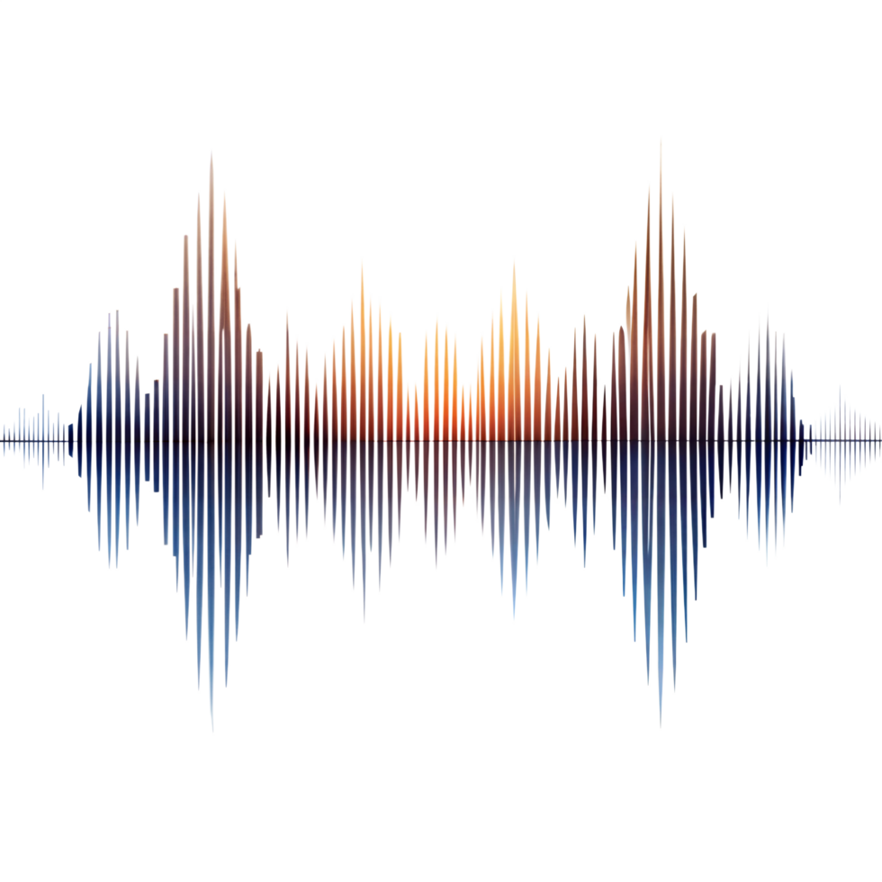
Audio Deepfake Detection
May Rozen, 212051007
Rotem Melamed, 209039072

Slide 2
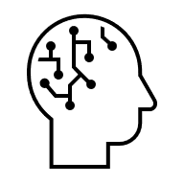

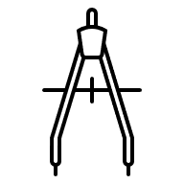


Roadmap
Motivation
Data Preparation
CLAD Architecture
Training & Results
Model Improvements

Slide 3

Motivation
Audio deepfakes pose serious security and societal risks
Current detectors fail under real-world manipulations
Notes:
Audio deepfakes pose serious security and societal risks: Advances in speech synthesis enable attackers to generate highly realistic fake voices, which can be used for scams, impersonation, bypassing voice authentication systems, or spreading misinformation — all without raising human suspicion
Current detectors fail under real-world manipulations: Even simple audio edits like changing volume or fading can fool state-of-the-art detection systems. These manipulations are cheap, realistic, and don’t require prior knowledge of the detection model, making them a powerful tool for attackers

Slide 4
Building the Fake-Audio Dataset

Slide 5

Data Preparation
Dataset: VCTK (diverse speakers by gender, age, accent)
Fake Generation: Coqui TTS (neural text-to-speech)Process
Load a pretrained neural TTS model (XTTS)
Provide text transcripts from VCTK
Use real speaker recordings as reference voices (via speaker ID)
Neural network synthesizes realistic speech in the target voice
Notes:
We used the VCTK dataset, which contains recordings from speakers of different genders, ages, and accents. To generate fake audio samples, we used Coqui TTS, a neural text-to-speech synthesis library capable of producing highly realistic speech. The fake generation process involved: Loading a pretrained TTS model. Feeding it selected text prompts. Synthesizing speech using the target speaker’s voice (via speaker ID). Saving the generated audio files with labels indicating they are fake (e.g., generated_fake_p225.wav). This allowed us to create highly realistic deepfake audio samples, later used to train and evaluate our detection model.

Slide 6







Real vs Fake Audio Samples
p225
p226
p227
p228

Slide 7
Introducing CLAD

Slide 8
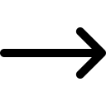

CLAD Architecture Overview
STEP 1
STEP 2
STEP 3
STEP 4
STEP 5
Audio Preprocessing
Model Architecture (CLAD)
Training & Evaluation
Results and Comparing to CNN
Model Improvement
Notes:
טוענים את המודל דרך הגיט של המודל
מבצעים את כל ההתקנות שנדרשות
מבצעים וקטוריזציה
מנרמלים את קטעי האודיו על ידי padding לכך שכולם יהיו באורך 4 שניות ובעלי 16khz
מכניסים את הנתונים למודל
מריצים epochs – בכול פעם קובע נתונים אחרים ל train val and test

Slide 9
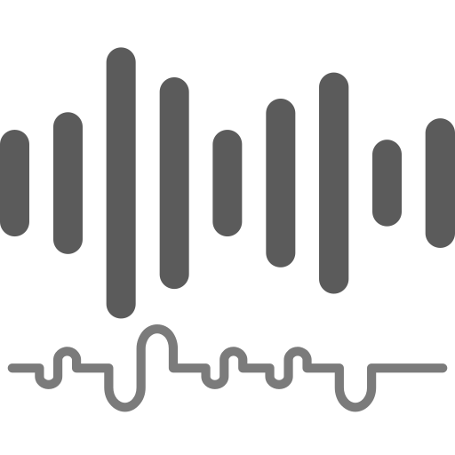

Split into Train/Val/Test by speakers to prevent identification based on speaker features.
Resampled all clips to 16kHz mono, loudness-normalized to −23 LUFS and padded/truncated each to 4 seconds (64,600 samples).
Audio Preprocessing

Slide 10
Utilizes a 1D CNN-based RawNet encoder to extract 1024-dimensional deep embeddings from raw 4-second audio waveforms.
The encoder employs 3 GRU layers for robust temporal feature learning.
A linear classifier generates the final binary (Real/Fake) prediction.
Model Architecture (CLAD)

Slide 11
Train
During training, each audio sample is randomly manipulated on-the-fly. This forces the model to learn robust features that can distinguish between real and fake audio — even under distortions.
The entire training is performed end-to-end using standard cross-entropy loss, without a separate pretraining stage.
Training & Evaluation
The Manipulations

Slide 12
At each iteration, we randomly add 2 out of 3 distortion types (Noise, Volume, Fade) to the audio sample.
This procedure forces the model to learn strong features, preventing it from relying on superficial cues such as clean audio.
The manipulations are subtle and designed so as not to distort speech structure or semantics.
The Manipulations
Volume Scaling
Fades
Noise Injection

Slide 13
Test
During the test phase, the model was evaluated on audio samples containing stronger and more targeted manipulations.
In other words, the evaluation exposed the model to harsher and more challenging conditions than those seen during training — demonstrating true robustness.
No training or fine-tuning occurs during testing — weights remain frozen
Training & Evaluation

Slide 14
Fake F1 | Fake Recall | Fake Precision | Accuracy | Test Set | Training | Model
93.06% | 90.04% | 96.3% | 93.29% | Clean | Robust | Base CLAD/ RawNet
87.14% | 79.22% | 96.83% | 88.31% | Attacked (Hard) | Robust | Base CLAD/ RawNet
Results

Slide 15
The CNN model operates on mel-spectrograms - 2D representations of audio where time and frequency form an image-like structure. This allows the model to apply convolutional layers for classification.
Two CNN models were trained:
Clean-trained CNN — trained solely on clean mel-spectrograms without any augmentations.
Augmented CNN — trained on mel-spectrograms with the same manipulations used during CLAD training.
Comparing to CNN

Slide 16
Fake F1 | Fake Recall | Fake Precision | Accuracy | Test Set | Training | Model
97.44% | 98.7% | 96.2% | 97.4% | Clean | Clean | Baseline CNN
61.87% | 55.84% | 69.35% | 65.58% | Attacked (Hard) | Clean | Baseline CNN
94.43% | 99.13% | 90.16% | 94.16% | Clean | Robust | Robust CNN
95.12% | 96.97% | 93.33% | 95.02% | Attacked (Hard) | Robust | Robust CNN
Results

Slide 17
So far, we saw that a Robust CNN can reach≈95% accuracy on attacked data – very close to our RawNet model. However, accuracy is measured at a single operating threshold.
In real security applications (e.g., voice authentication), we care about the trade-off between:
False Accepts (letting deepfakes in)
False Rejects (blocking real users)
To capture this trade-off, we look at the Equal Error Rate (EER).
Comparing to CNN

Slide 18
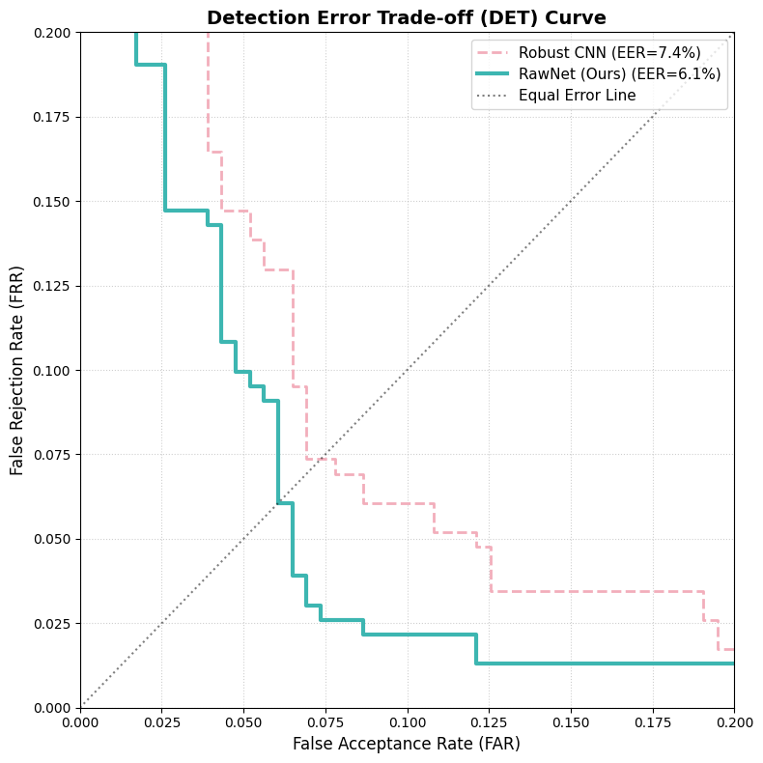
Results

Slide 19
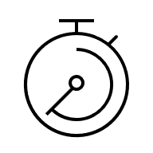
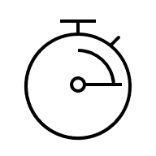

Pre-training Removal & Faster Iteration: We removed the complex MoCo-style contrastive pre-training stage and trained the model end-to-end instead. This simplified the pipeline, significantly reduced compute and training time, and shortened the development cycle, while also eliminating components such as dual encoders and the memory queue.
Model Improvement

Slide 20


Additional Improvements & Feature Noise:
We experimented with several enhancements, including alternative loss functions (focal / length loss) and learning-rate tuning. The most effective improvement was adding small Gaussian feature noise to the raw embedding vectors, which increased the discriminative margin and led to our best accuracy.
Model Improvement
65.58%
96.10%

Slide 21
E2E With feature noise:
injects light noise into embeddings to boost robustness
Fake F1 | Fake Recall | Fake Precision | Accuracy | Test Set | Training | Model
96.97% | 96.97% | 96.97% | 96.97% | Clean | Robust + FN | CLAD + Feature Noise
96.09% | 95.67% | 96.51% | 96.1% | Attacked (Hard) | Robust + FN | CLAD + Feature Noise

Slide 22
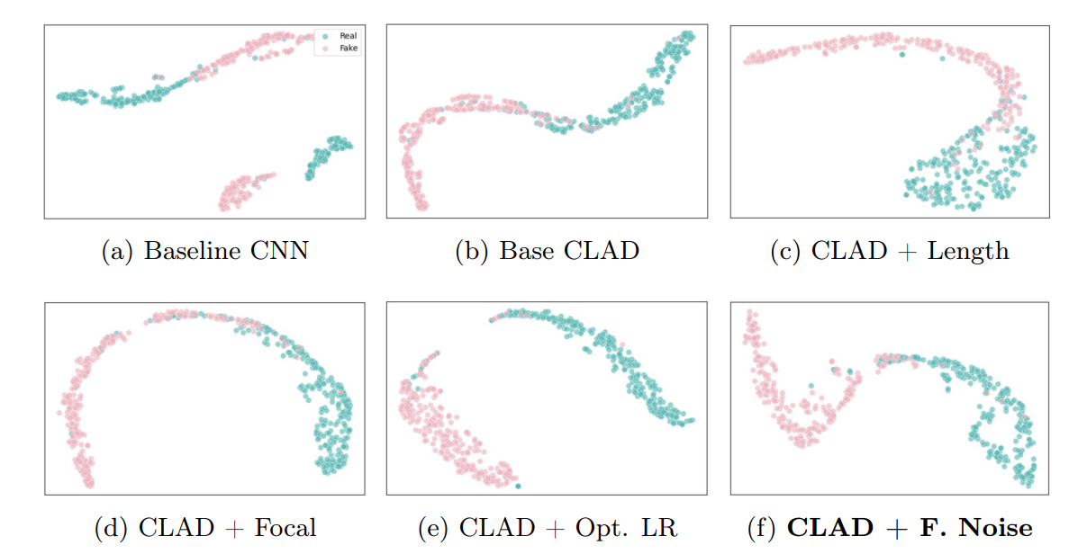

Slide 23
Robust and Stable Under Attack: By combining the RawNet core architecture with our streamlined training pipeline, the detector achieves an Equal Error Rate of 6.06% under strong manipulation attacks—substantially lower than the 7.36% EER of the best Mel-spectrogram CNN corresponding to a relative error reduction of 17.6%. This gap reflects a more stable and reliable decision boundary across operating thresholds, while still relying on modest computational resources and a different evaluation dataset than the original CLAD paper.
Model Improvement

Slide 24
Thank you for listening!
Questions?

